Slide 1


Fulvio Pinna
3 September 2024

Slide 2

Outline
Executive Summary
Introduction
Methodology
Results
Conclusion
Appendix

Slide 3
Executive Summary
Methodologies
Data collection through API
Data collection with scraping
Data wrangling
EDA with SQL
EDA with data visualization
Visual analytics using Folium
Machine Learning Prediction
Results
EDA result
Visual analytics in screenshots
Predictive analysis results

Slide 4
Introduction
Project background and context
SpaceX advertises Falcon 9 rocket launches on its website with a cost of 62 million dollars other providers cost upward of 165 million dollars each, much of the savings is because Space X can reuse the first stage Therefore, if we can determine if the first stage will land, we can determine the cost of a launch. This information can be used if an alternate company wants to bid against space X for a rocket launch. The goal of the project is to create a machine learning pipeline to predict if the first stage will land successfully.
Problems you want to find answers
- What factors determine if the rocket will land successfully?
- Interaction of the features that determine the success rate of a successful landing.
- What conditions needs to be in place to ensure a successful landing program.

Slide 5

Section 1

Slide 6
Methodology
Executive Summary
Data collection methodology:
Data has been collected using SpaceX API and web scraping from Wikipedia.
Perform data wrangling
One hot encoding it has been applied to categorical features
Perform exploratory data analysis (EDA) using visualization and SQL
Perform interactive visual analytics using Folium and Plotly Dash
Perform predictive analysis using classification models

Slide 7
Data Collection
Data has been collected using different methods
Data collection was performed using get request to the SpaceX API
Next, we transformed the response content as a Json and turn it into a pandas dataframe
Then data has been cleaned, filling missing values with the mean
After through web scraping we got data from Wikipedia for Falcon 9 launch using BeautifulSoup
The goal was to obtain the launch records as HTML table, parse the table and convert it to a dataframe

Slide 8
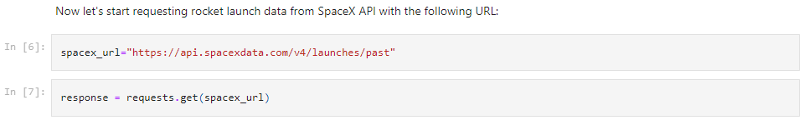
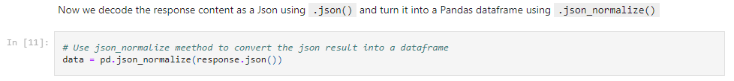
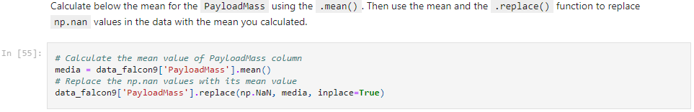
Data Collection – SpaceX API
I used the get request to the SpaceX API to collect data, clean the requested data and did some basic data wrangling
The link to the notebook is
Data collection

Slide 9
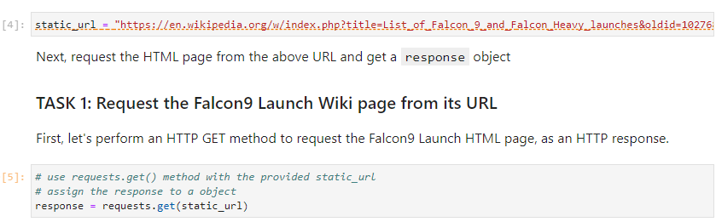
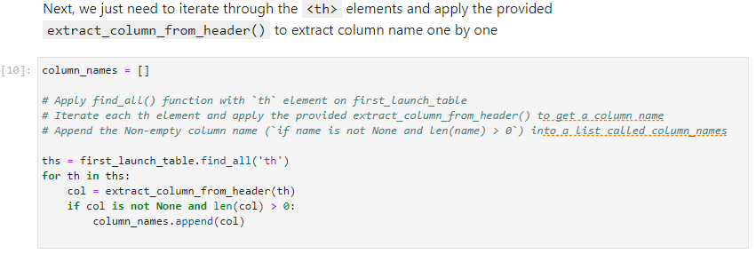
Data Collection - Scraping
Webscrap Falcon 9 launch records with BeautifulSoup from Wikipedia
Parsed the table and converted it into a pandas dataframe.
The link to the notebook is
Web Scraping

Slide 10
Data Wrangling
I performed exploratory data analysis and determined the training labels.
Calculated the number of launches for each site, and the number and occurrence of each orbits.
Created landing outcome label from outcome column and exported the results to csv.
The link to the notebook is Data Wrangling

Slide 11
EDA with Data Visualization
I explored the data and show the relationship between flight number and launch Site, payload and launch site, success rate of each orbit type, flight number and orbit type, the launch success yearly trend.
The link to the notebook is Exploratory Data Analysis

Slide 12
EDA with SQL
I applied EDA with SQL to get insight from the data and wrote queries to find out:
The names of unique launch sites in the space mission.
The total payload mass carried by boosters launched by NASA (CRS)
The average payload mass carried by booster version F9 v1.1
The total number of successful and failure mission outcomes
The failed landing outcomes in drone ship, their booster version and launch site names.
The link to the notebook is EDA with SQL

Slide 13
Build an Interactive Map with Folium
I marked all launch sites, and added map objects such as markers, circles, lines to mark the success or failure of launches for each site on the folium map.
Assigned the feature launch outcomes (failure or success) to class 0 (failure) and 1 (success).
Calculated the distances between a launch site to its proximities and answered some question like:
Are launch sites near railways, highways and coastlines.
Do launch sites keep certain distance away from cities.
The link to the notebook is Visual analytic with Folium

Slide 14
Build a Dashboard with Plotly Dash
I built an interactive dashboard with Plotly dash.
Plotted pie charts showing the total launches by a certain sites.
Plotted scatter graph showing the relationship with Outcome and Payload Mass (Kg) for the different booster version.
The link to the notebook is Dashboard

Slide 15
Predictive Analysis (Classification)
I loaded the data using numpy and pandas, transformed the data, split our data into training and testing.
Built different machine learning models and tune different hyperparameters using GridSearchCV.
Used accuracy as the metric for our model, improved the model using feature engineering and algorithm tuning.
Found the best performing classification model.
The link to the notebook is Machine Learning Prediction

Slide 16
Results
Exploratory data analysis results
Interactive analytics demo in screenshots
Predictive analysis results

Slide 17

Section 2

Slide 18
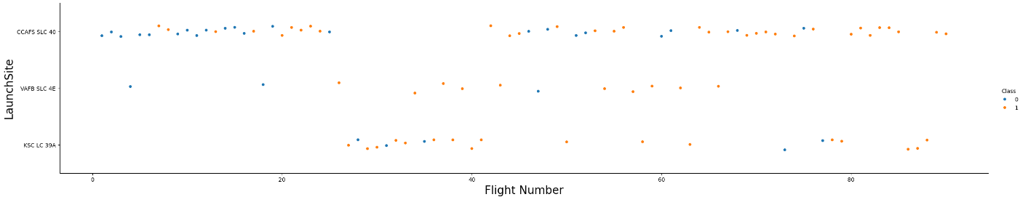
Flight Number vs. Launch Site
From the plot, you can see that the larger is the number of flight at a launch site, the greater is the success rate for that launch site.

Slide 19
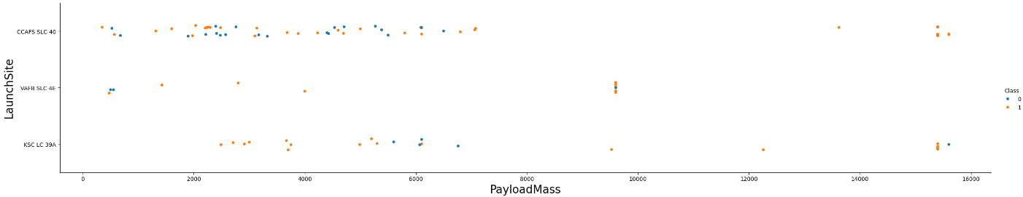
Payload vs. Launch Site
Positive correlation between the payload mass for launch site with the success rate for the rocket.

Slide 20
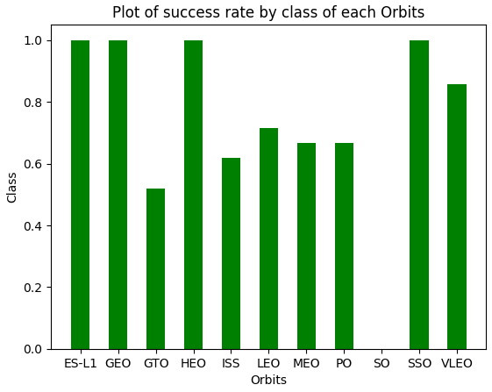
Success Rate vs. Orbit Type
From the plot, is possible to find out that ES-L1, GEO, HEO, SSO, VLEO had the most success rate.

Slide 21
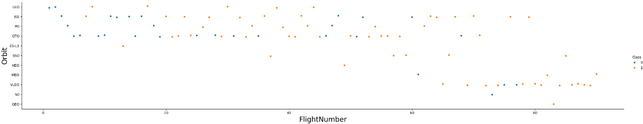
Flight Number vs. Orbit Type
Is possible to generalize that for all the orbits the success for the next launch is higher as the number of attempts grow.

Slide 22
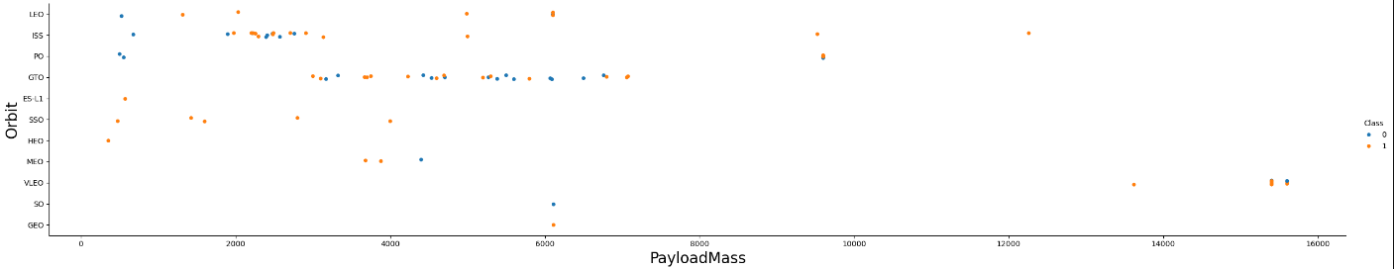
Payload vs. Orbit Type
Only for the orbits PO, VLEO and ISS the payload mass are grater than 8000, and the majority of them shows a success.

Slide 23
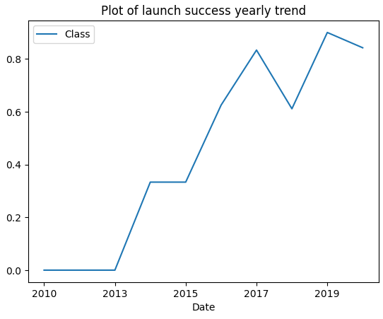
Launch Success Yearly Trend
The plot, show that the success rate since 2013 kept on increasing till 2020.

Slide 24
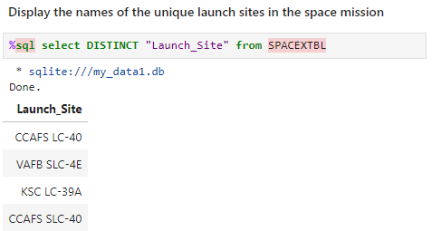
All Launch Site Names
The command DISTINCT is been used to show only unique launch sites from the data.

Slide 25
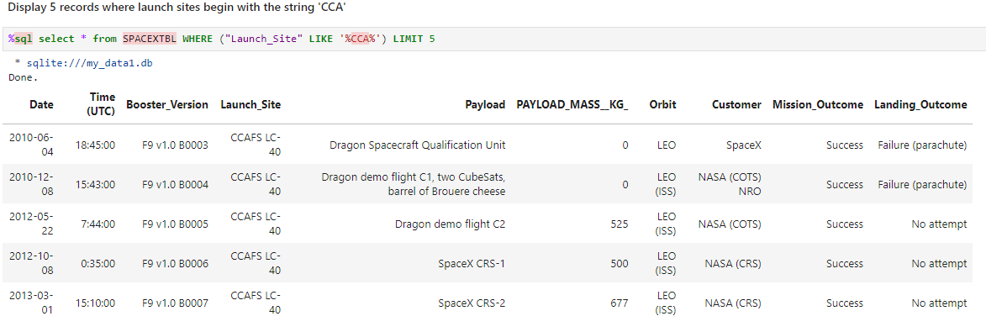
Launch Site Names Begin with 'CCA'
The query above display the first 5 records of the database where launch sites contains `CCA`

Slide 26
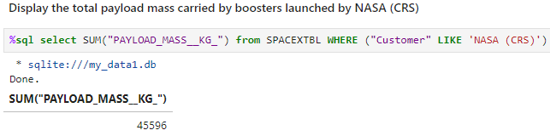
Total Payload Mass
The total payload carried by boosters from NASA (CRS) is been calculated using the SUM function over PAYLOAD_MASS variable, filtering the database by customer.

Slide 27
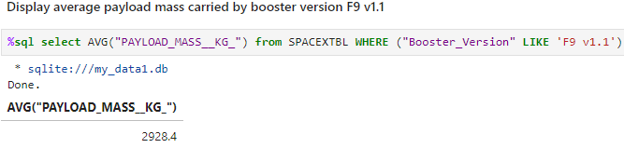
Average Payload Mass by F9 v1.1
The average payload mass carried by booster version F9 v1.1 is 2928.4 and was calculated using the following command

Slide 28
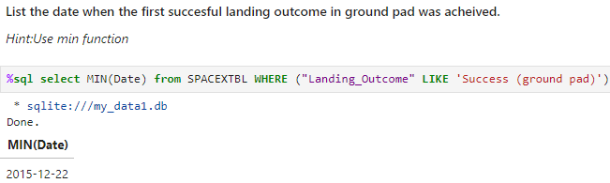
First Successful Ground Landing Date
The date of the first successful landing outcome on ground pad was is been found using the MIN function and a simple filter on the Landing Outcome field.

Slide 29
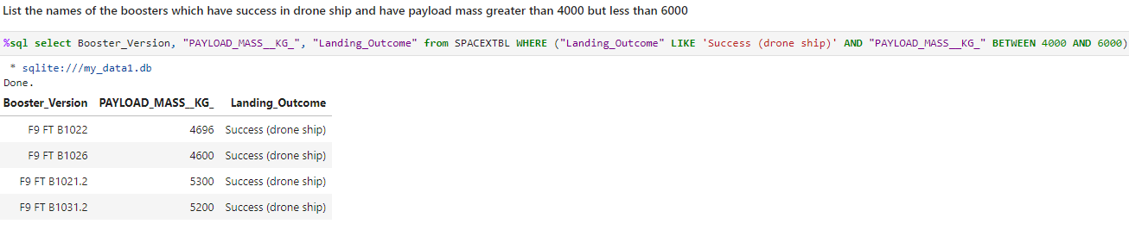
Successful Drone Ship Landing with Payload between 4000 and 6000
Using WHERE function and filtering applying the AND condition for Landing Outcome and Payload Mass fields the result is show below.

Slide 30
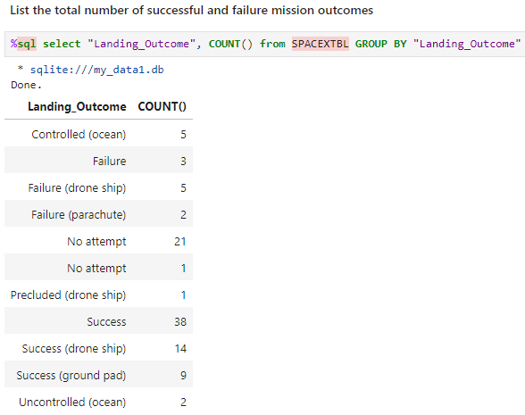
Total Number of Successful and Failure Mission Outcomes
Is possible to find out the number of success and failure using the simple function COUNT() and grouping the dataset for each distinct element of Landing Outcome.

Slide 31
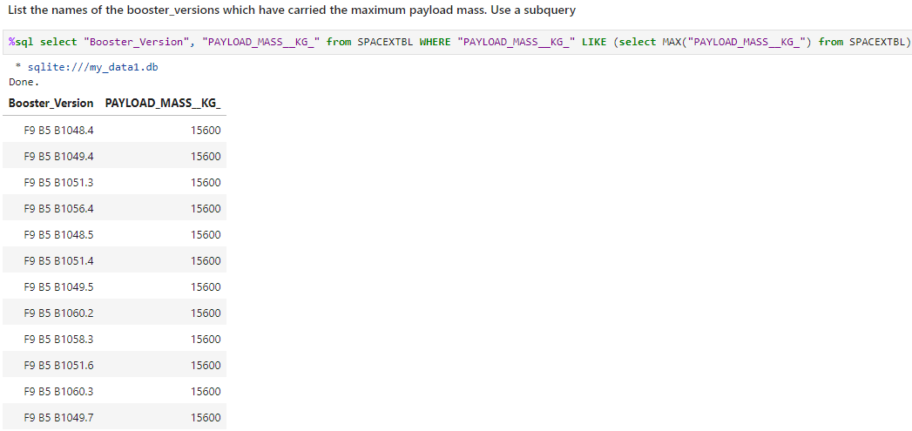
Boosters Carried Maximum Payload
The booster that have carried the maximum payload is been selected using a subquery in the WHERE clause and the MAX() function.

Slide 32
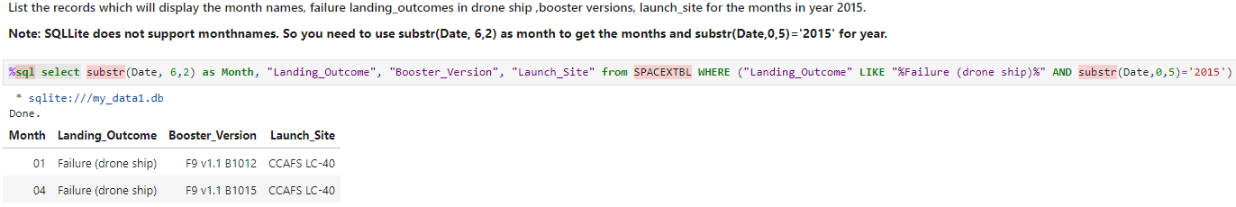
2015 Launch Records
Using a combinations of the WHERE, LIKE, AND, and the function “substr” to filter for year 2015 and failed landing outcomes in drone ship. The result is show below.

Slide 33
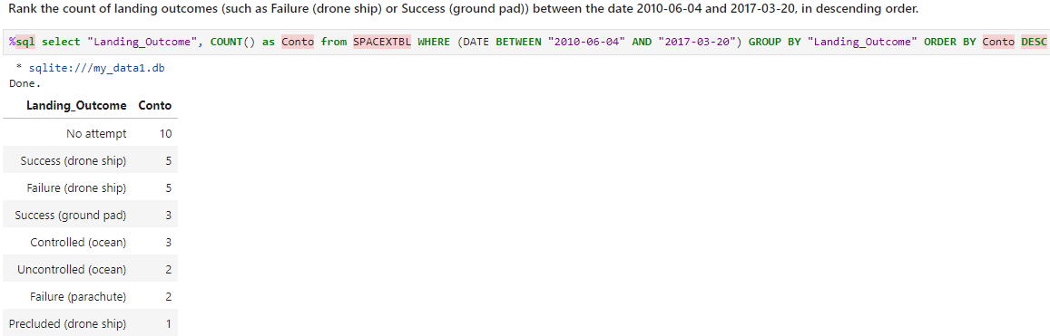
Rank Landing Outcomes Between 2010-06-04 and 2017-03-20
Rank the count of landing outcomes between the date 2010-06-04 and 2017-03-20, in descending order.

Slide 34

Section 3

Slide 35
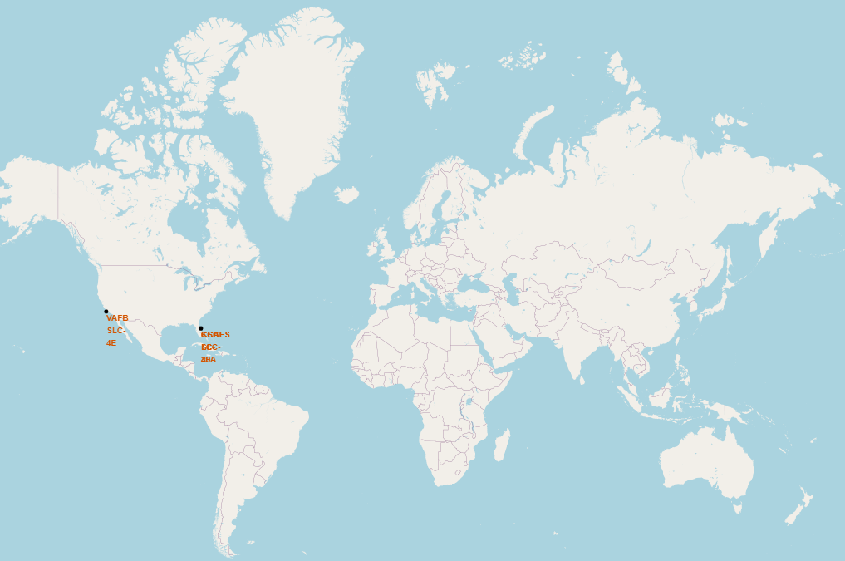
Lauch sites marked on global map

Slide 36
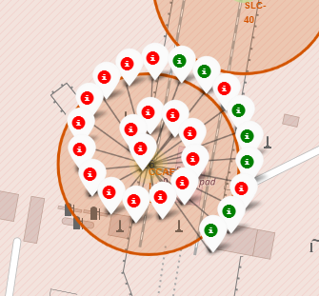
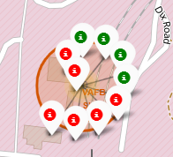
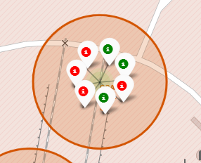
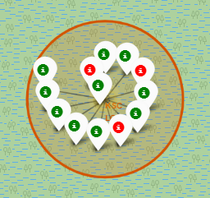
Launch sites with labels
Green markers shows when a launch is been a Success, otherwise the red ones represent the Failures.

Slide 37
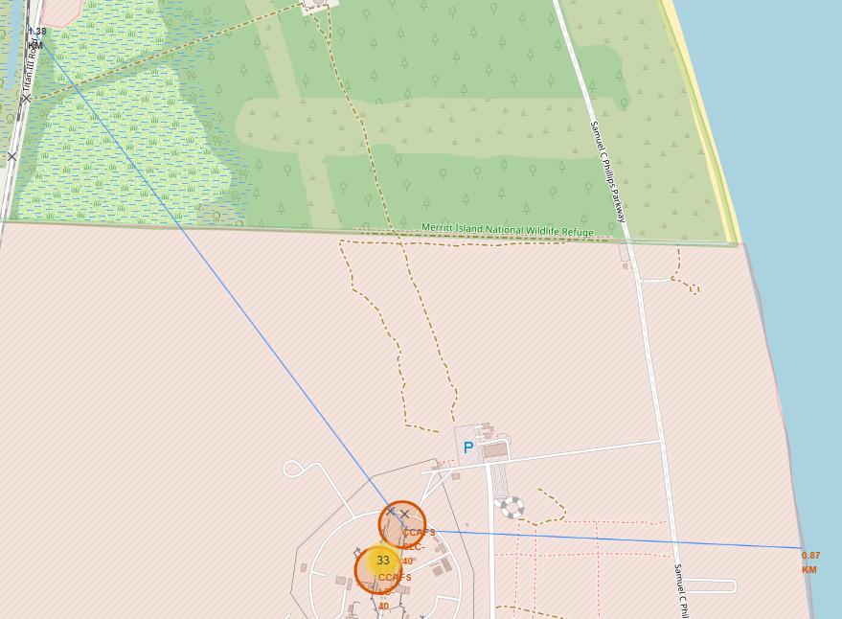
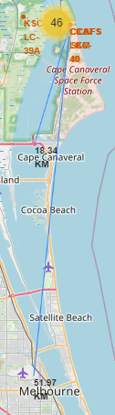
Distance to coast, city, railway and highway
Is possible to notice that Florida’s launch sites are closer to the coast (0.97 km) and the Railway (1.38 km), compare to the highway (18.34 km) and Melbourne (51.07 km).

Slide 38

Section 4

Slide 39
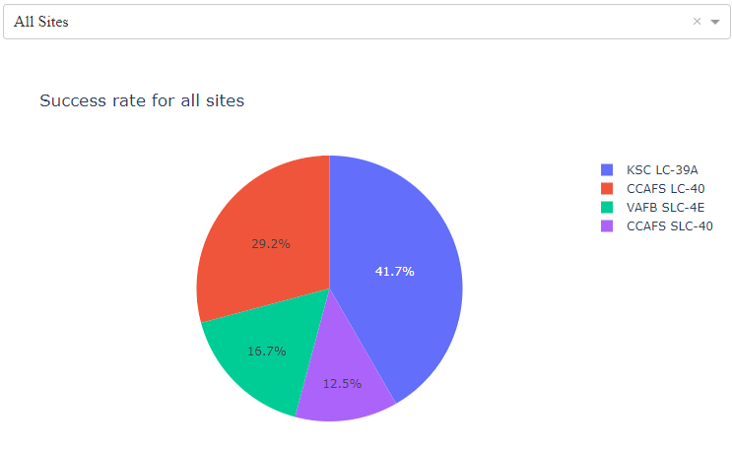
Success ratio by launch sites
Find out that KSC LC has the most successful launches

Slide 40
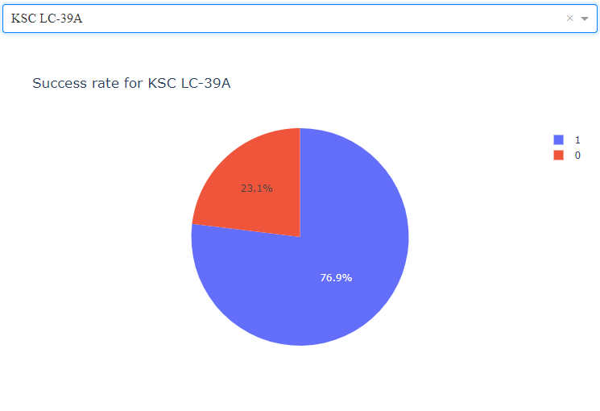
Success ratio for KSC LC
KSC LC at the moment show a percentage of success of almost 77%

Slide 41
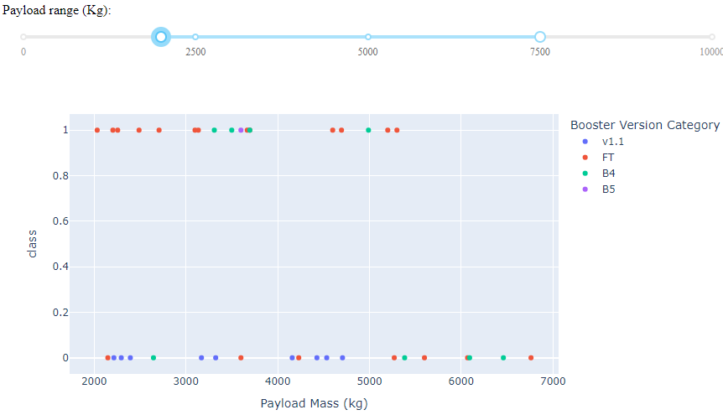
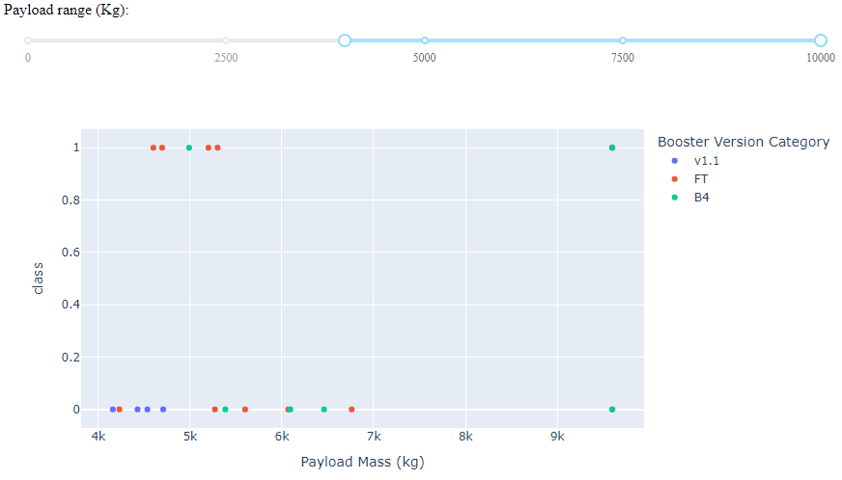
Scatter plot of Payload vs Launch Outcome for all sites
Success rate for lower weighted payload is higher compared to the heavy weighted.

Slide 42

Section 5

Slide 43
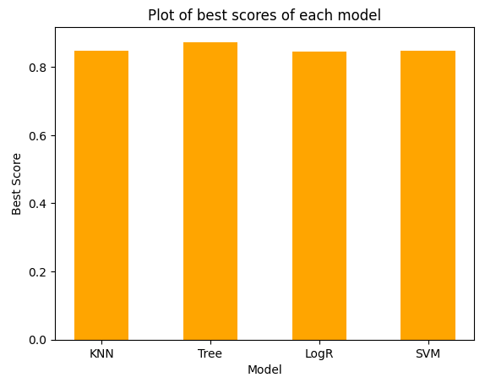
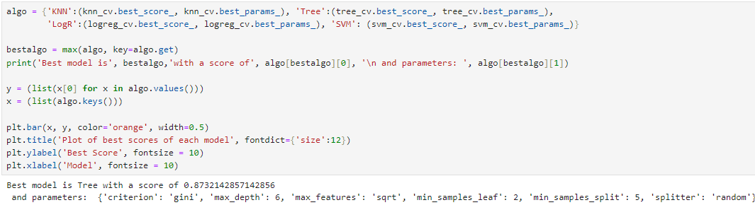
Classification Accuracy
Decision tree is the model with the best classification score

Slide 44
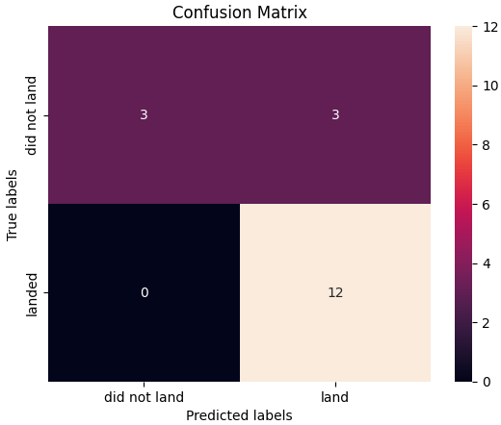
Confusion Matrix
Confusion matrix for the decision tree classifier shows that the model can distinguish between the different classes.
The main error seems to be the false positives, 3 unsuccessful launch are labeled as successful by the classifier.

Slide 45
Conclusions
The higher are the number of flight for a launch site, the better is the success rate for that launch site.
Launch success rate show a strong increment from 2013 till today.
Orbits ES-L1, GEO, HEO, SSO, VLEO has the most success rate.
KSC LC-39A has the most successful launches of any sites.
The Decision tree classifier is the best machine learning algorithm for this project.

Slide 46


